Slide 1
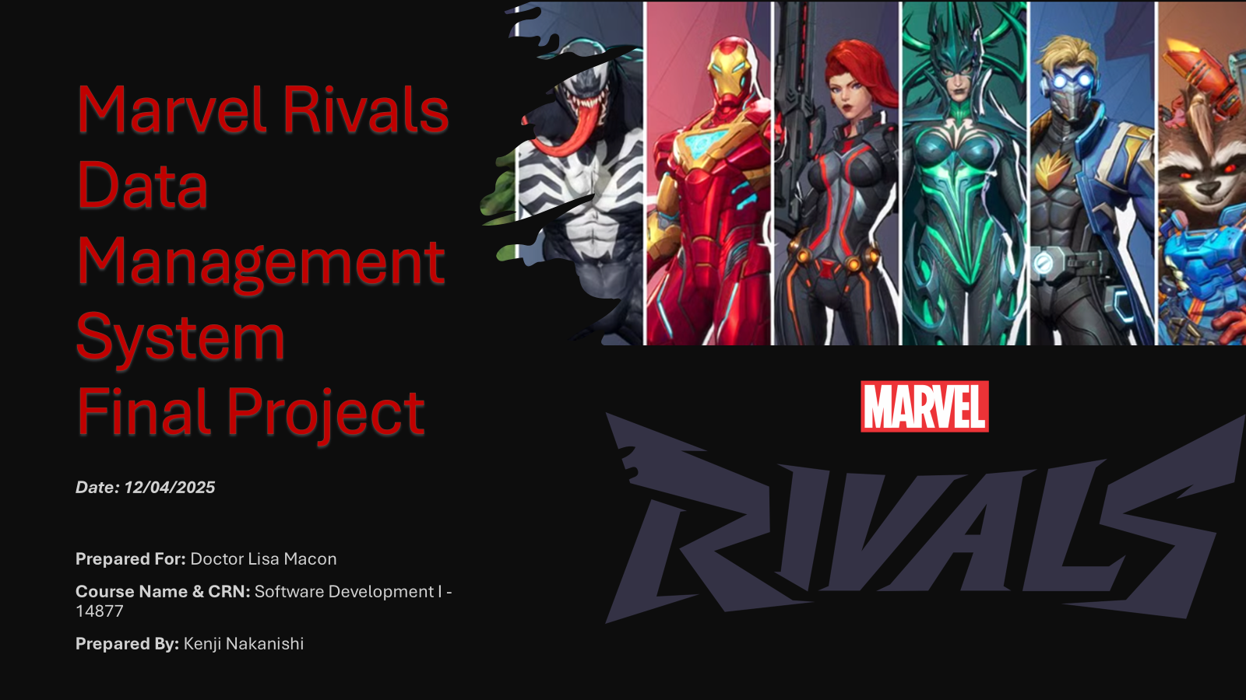
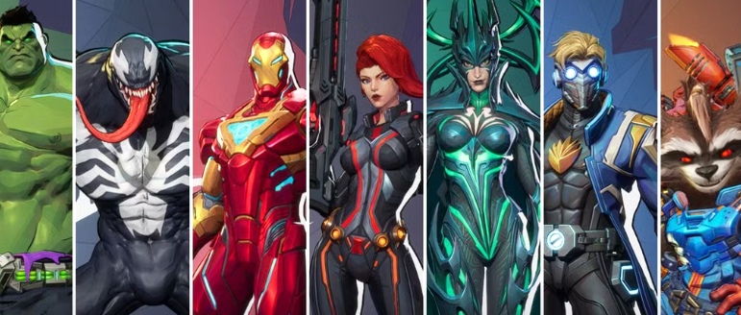

Marvel Rivals Data Management System Final Project

Slide 2
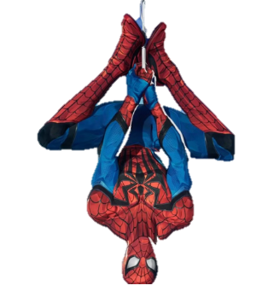

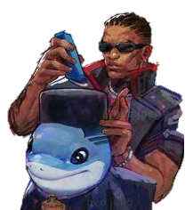
Table of Content
1. Introduction
2. Requirements
3. Implementation Plan
4. Testing
5. Deployment
6. Phases
7. Demonstration
8. Conclusion & Reflection

Slide 3

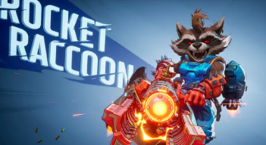
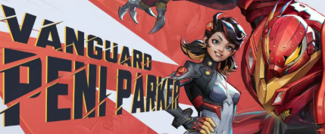

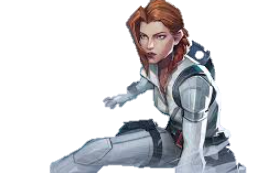
1. Introduction
Data Management System!
-> Software designed organize DATA & this performs CRUD Operations;
- Create
-Read
-Update
-Delete
Project is divided on Phases I, II, III, IV where logic, testing, database, and GUI is added! -> Favorite Game: Marvel Rivals

Slide 4
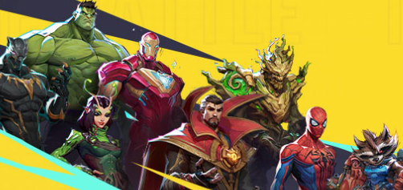

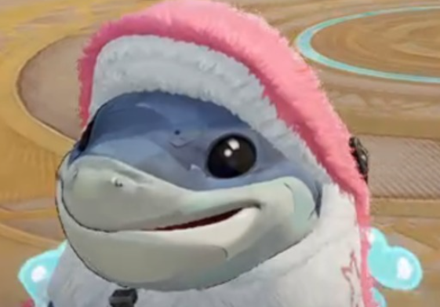
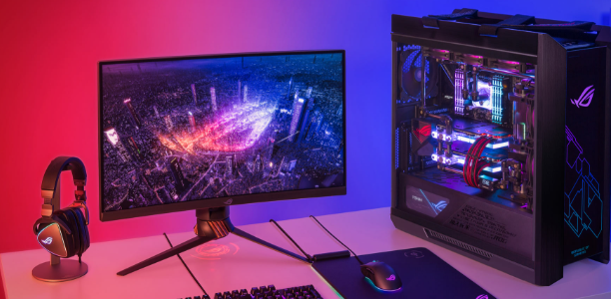
2. Requirements
Hero Class Fields:
Identity_Hero_ID (integer) e.g. 050
Hero_Name (string) e.g Invisible Woman
Health_Point (integer) e.g 750 HP
Movement_Speed (integer): e.g 8 m/s
Ult_Damage (integer) e.g 150 dps
Hero_Role (string): e.g Duelist, Strategist, and Vanguard.
Custom Method:
Win_Rate (double): Matches won /matches played * 100 e.g. 57.50% Magik
Speed: Response within 5 seconds.
Size: run in <256 MB of memory.
Storage: support storage of > 100 heroes
Ease of Use: Training time < 1 hour.
Reliability: Availability > 80%
Robustness: recovers from crash within < 2 minutes.
Portability: Windows 11 64-bit / Java / SQLite
CRUD Operations
Console based Logic + GUI + Database
Never crashing program, exit when user enter exit.

Slide 5
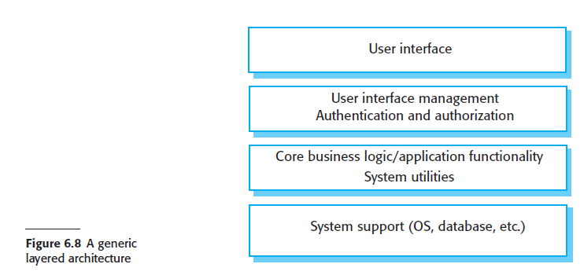
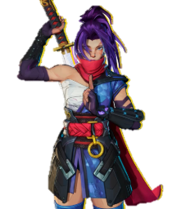
3. Implementation Plan
Architecture pattern: Layered scale up on course structure; Phase 3/GUI & Phase 4/Database
Table model GUI; DB Connection
Software Engineering third edition Ian Sommerville Page 178
DMS will be generated as following:
CONSOLE & GUI
MarvelRivalsApp (main)
NavigationMenu Start()
DisplayNavigation()
USER INTERFACE MGNT
Phase 1
No authentication yet
CORE BUSINESS LOGIC
HeroFunctionalities:
add, getHero, update, remove, list, topWinRate, importFrom
SYSTEM SUPPORT
Phase 1
JdbcHeroRepository for GUI
Phase 4
SQLLiteHeroRepository

Slide 6
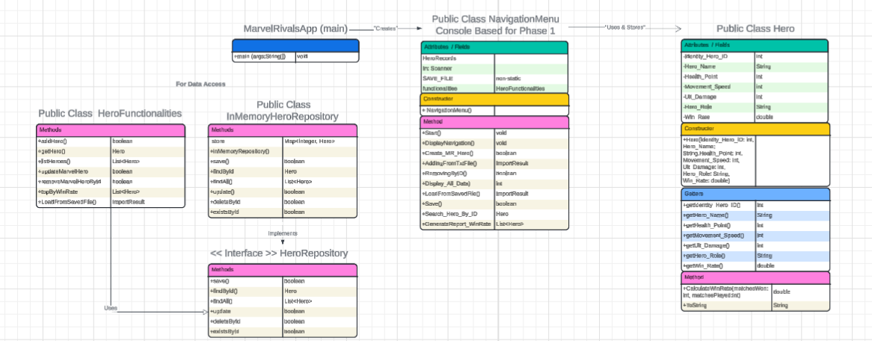
Hero Class + Database Connection + Logic
URL: https://lucid.app/lucidchart/18e515b2-9180-480a-88ba-ca03a5577c65/edit?viewport_loc=2054%2C-917%2C3134%2C1109%2C0_0&invitationId=inv_004111e4-c397-44a1-9532-7ea265477788

Slide 7

4. Testing
Add
Create_MarvelRivals_Hero()
Remove
RemoveByID()
Update
UpdateMR_Hero()
GenerateReportByWinRate
Custom Action
Update_Win_Rate
Canva: https://www.canva.com/design/DAG07aTaRiE/BeaOak-9wV0z5ZcLjhoKgw/edit?utm_content=DAG07aTaRiE&utm_campaign=designshare&utm_medium=link2&utm_source=sharebutton

Slide 8

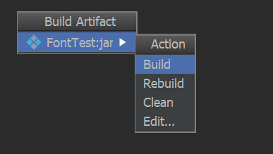

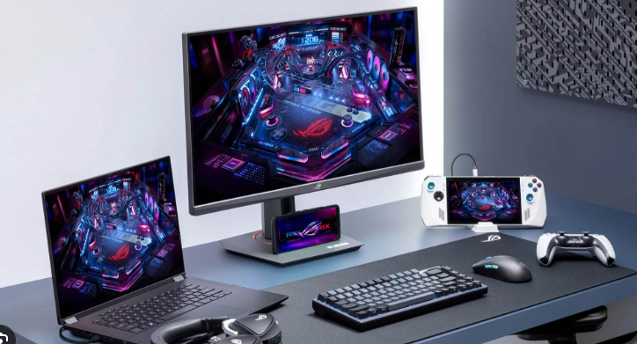
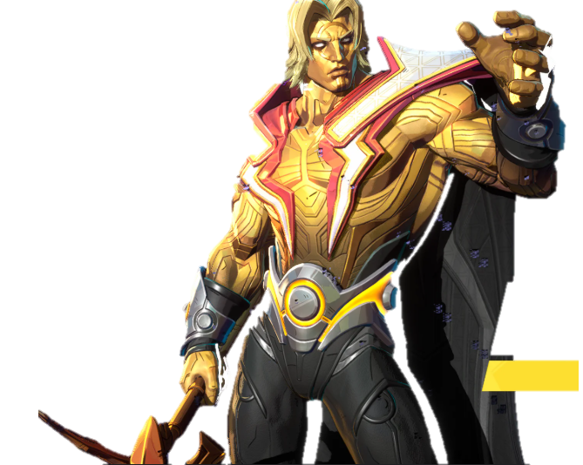
5. Deployment
- Using a JAR executable - > Build Artifacts JAR
- Tested JAR on my Laptop and PC before submitting assignment to make sure app opens.
- Including .class files and required package
- When executing JAR we run command:
java –jar MarvelRivalsDMS.jar

Slide 9

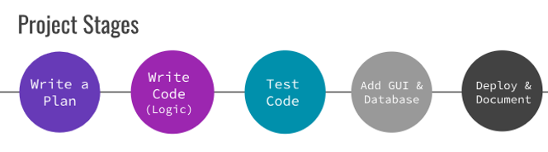
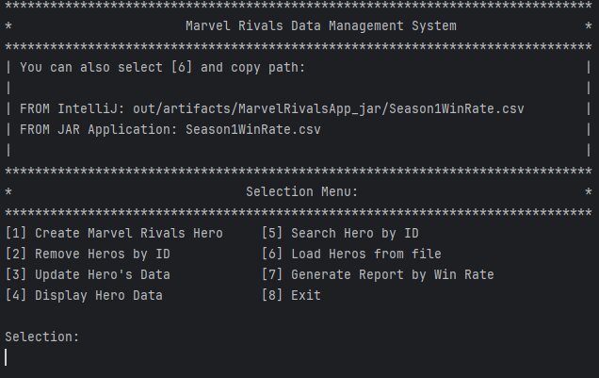
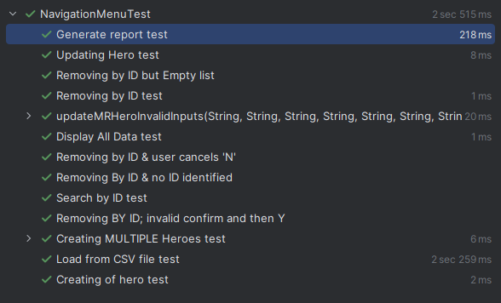
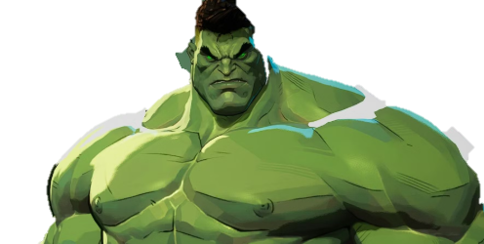
6. Phases I & II
Phase 1: Logic and Data Validation
- CRUD Operations;
User can: Create Marvel Rivals Hero, Remove Heroes by ID, Update Hero’s Data, and Display Hero Data
Custom Method: PDF Report creation
https://github.com/kenjisan624/COP-3330C-Module-7-Phase1
& Phase 2: Testing:
Used sample .csv + .txt with +42 heroes' data.
Temporarily In-memory Java Object (List<Hero>) while the program runs and Text file - CSV file
https://github.com/kenjisan624/COP-3330C-Module-8-Phase2-Public

Slide 10
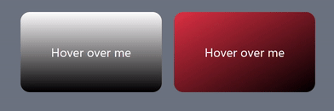
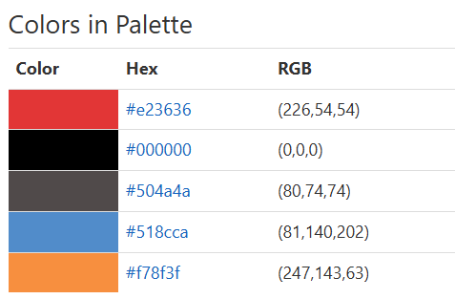
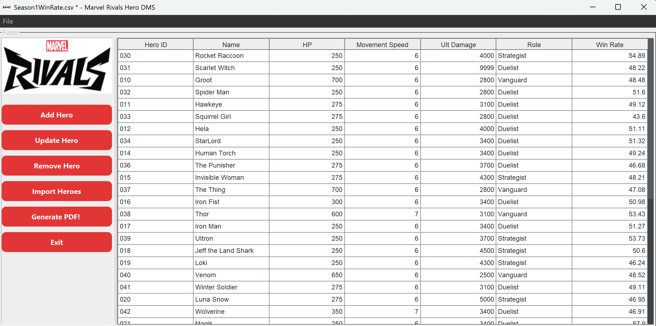
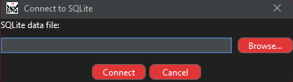
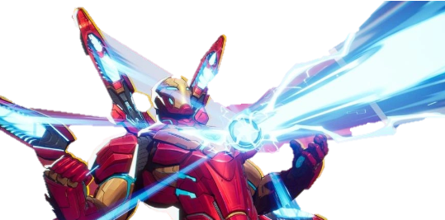

Phase III & IV
Phase 3: GUI
- Inspired on color palette from Marvel & Marvel Rival roaster:
- Fields to input records & Rows of fields with objects
- Hover over picture reference
https://github.com/kenjisan624/COP-3330C-Module-9-Phase3
Phase 4: Database
Incorporate Database functionality
https://github.com/kenjisan624/COP-3330C-Module-10-Phase4-Marvel-Rivals-DMS

Slide 11


7. Demonstration
Let jump to IntelliJ

Slide 12

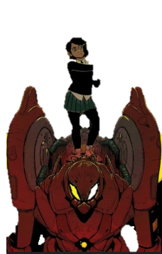

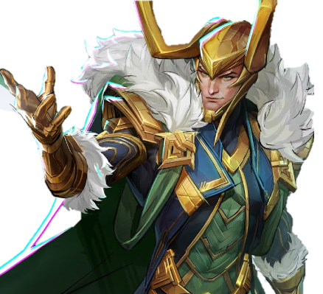
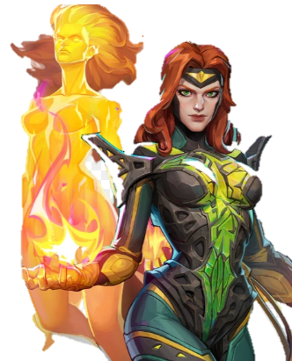
8. Conclusion & Reflection
Ideas ≠ actual coding process
Something that looks easy might tend to be complex when writing code
The more you code, the more feature you want to add or edit to the initial plan
Fun!; Enjoyed recording Video explanation + GitHub repo; Led me to learn more about myself and to grow my professional portfolio.

